Slide 1
VBA PROJECT – AUTOMATING WORKSHEETS REPORTING BY OFFODUM, OKECHUKWU GREGORY
APRIL 9, 2021

Slide 2

“IMPOSSIBLE only means that you haven’t found the solution yet”

Slide 3
OUTLINE
Introduction
Methodology
Results & Conclusion
VBA Project
April 9, 2021

Slide 4
INTRODUCTION

Slide 5

BACKGROUND INFORMATION
Six (6) workbooks (Addis Ababa, Havana, Kano, Lagos, Oslo, Tokyo) represent different subsidiaries.
Each workbook consisting of five (5) columns each depict name, staff ID, role, and salary information
Automation using VBA is required to summarize and export vital information from each sheet
VBA Project
April 9, 2021

Slide 6
OBJECTIVES
Populate the sum salaries of individual roles for every subsidiary
Generate a pdf summary for each workbook/subsidiary
Generate a general sum total report of all spreadsheets
VBA Project
April 9, 2021

Slide 7
METHODOLOGY

Slide 8
METHODOLOGY
FOR INDIVIDUAL SUBSIDIARY BOOKS
Dimension variables accordingly
Workbook, worksheet, file path, file name, ‘i’ for FOR loop.
‘file’ variable is the names of sheets to be iterated located in the current worksheet
Utilize a FOR loop for the entire code to iterate for all sheets
Call the file path in C drive such that every ‘file’ is opened
Use sheet.range.value to locate/create cells for labels and computed values
Apply sumIF(Range) function to sum the salary of each role, and place in the previously created cells
Use exportAsPDF function to export PDF for each ‘file’ accordingly
VBA Project
April 9, 2021

Slide 9
METHODOLOGY
FOR TOTAL REPORT SHEET
Use sheet.range.value to locate/create cells for labels and computed values.
Use sheet.pastespecial with xlAdd condition to do a cumulative sum of roles for all subsidiaries.
Use exportAsPDF function to export PDF for total summary report.
VBA Project
April 9, 2021

Slide 10
RESULTS AND CONCLUSION

Slide 11
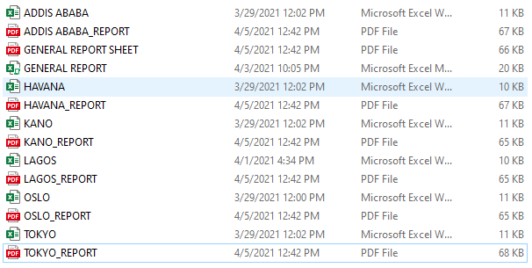
RESULTS
A total of 14 files were created, excel and pdf reports for each subsidiary and general summary:
12 subsidiary reports (for each subsidiary)
2 general summary report
VBA Project
April 9, 2021

Slide 12
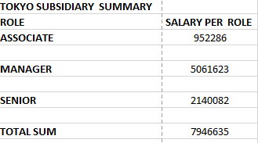
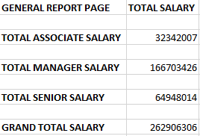
RESULTS
Individual subsidiary summary
Total report summary
VBA Project
April 9, 2021

Slide 13
CONCLUSION
VBA programming has been successfully used to automate a summary report of information contained in six (6) different sheets.
VBA Project
April 9, 2021

Slide 14
THANK YOU

